Slide 1
FUUAST CMS - Complaint Management System
• Final Year Project - Federal Urdu University
• Student: Aimal Khan Ahmed Khan - FUUAST-2022-BSCS-XXX
• Features: FCMS-2026-0001 Auto ID | Anonymous | 72h Escalation | Email
• Tech: Laravel 11, PHP 8.2, SQLite, Blade, Tailwind
• GitHub: 48 Commits - aimalkhanbangash11111-design/fuuast-cms
• Admin Login: coordinator@fuuast.edu.pk / 12345678
• Viva Points: FCMS ID, Anonymous, 72h Auto, Email Notification

Slide 2
Problem Statement - Why FUUAST CMS?
• Manual complaint system: Papers lost, no tracking, no transparency
• Students afraid to complain due to identity reveal - fear of teacher
• No escalation if coordinator doesn't act within time
• No email notification on status change - student doesn't know result
• Solution: Digital CMS with FCMS-2026-0001 auto tracking, Anonymous feature, 72h Auto-Escalation, Email Notification
• Benefits: Transparency, Privacy, Accountability, Digital Record

Slide 3
Key Features - Week 5 to Week 8
• Week 5: FCMS-2026-0001 Auto ID Engine - Format: FCMS-YYYY-XXXX - Unique, auto increment - + Anonymous Checkbox (is_anonymous boolean)
• Week 6: My Complaints Page - Student sees all complaints with FCMS code, status badges - Search by FCMS-2026-0001 - Tracking
• Week 7: Admin Panel /admin/complaints - View all, update status Pending->In-Progress->Resolved + Remarks - 72h Auto-Escalation Command
• php artisan complaints:escalate - Checks pending >72h - Auto status to escalated - Terminal proof: 1 complaints escalated after 72h!
• Week 8: Email Notification - ComplaintStatusMail - resources/views/emails/complaint_status.blade.php - From fuuast@fuuast.edu.pk
• Proof: storage/logs/laravel.log + Gmail Inbox shows FCMS-2026-0001 Resolved emails

Slide 4
Tech Stack & Architecture
• Backend: Laravel 11, PHP 8.2, SQLite (database.sqlite) - No MySQL needed, portable
• Frontend: Blade Templates, Tailwind CSS, HTML, JavaScript
• Laravel Features Used: Eloquent ORM, Console Commands (EscalateComplaints.php), Mailables (ComplaintStatusMail.php), Middleware, Migrations
• Tools: VS Code, Git & GitHub (48 Commits), XAMPP, dbdiagram.io for ERD, Notepad for laravel.log check
• Security: Anonymous flag hides name, Role-based access - student, coordinator, hod, admin - CSRF protection
• Config: SESSION_DRIVER=file, DB_CONNECTION=sqlite, MAIL_MAILER=log for viva testing

Slide 5
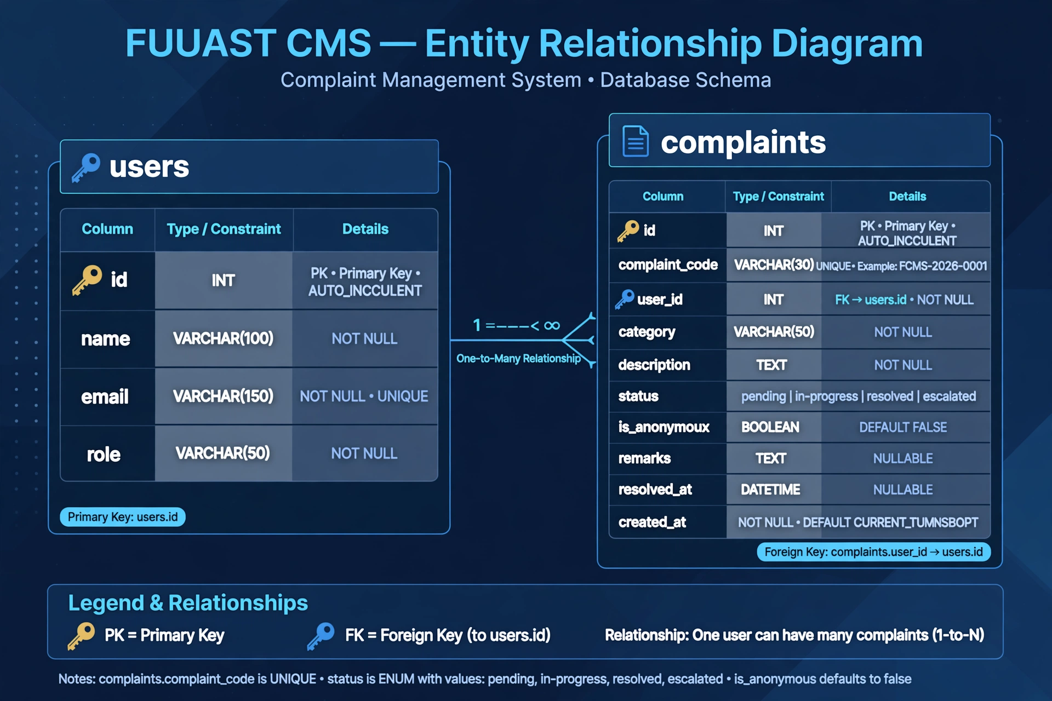
ERD - Entity Relationship Diagram
• Table 1: users - id (PK, INT, AUTO_INCREMENT), name VARCHAR(100) NOT NULL, email VARCHAR(150) UNIQUE NOT NULL, role VARCHAR(50) NOT NULL
• Table 2: complaints - id (PK), complaint_code VARCHAR(30) UNIQUE - Example FCMS-2026-0001, user_id INT FK->users.id NOT NULL
• complaints columns: category VARCHAR(50), description TEXT, status ENUM pending/in-progress/resolved/escalated, is_anonymous BOOLEAN DEFAULT FALSE
• More: remarks TEXT NULLABLE, resolved_at DATETIME NULLABLE, created_at DEFAULT CURRENT_TIMESTAMP
• Relationship: One User can have Many Complaints (One-to-Many) - Foreign Key: complaints.user_id -> users.id
• ERD saved in public/ERD.png - 161 KB - Shows in GitHub README as image
• Legend: PK=Primary Key, FK=Foreign Key, UNIQUE=No duplicates

Slide 6
Workflow - Student to Admin to Email
• Step 1: Student Register/Login -> Dashboard -> Submit Complaint -> Form: Category (Academic/Admin/Hostel), Description, Anonymous? Yes/No checkbox
• System auto generates: FCMS-2026-0001 - Saved in complaints table - complaint_code UNIQUE
• Step 2: Student -> My Complaints page -> List shows FCMS-2026-0001 with status pending (yellow badge), category, date
• Step 3: Admin Login coordinator@fuuast.edu.pk / 12345678 -> Route /admin/complaints -> Table shows all complaints including FCMS-2026-0001
• Admin updates status: pending to in-progress to resolved + adds remarks: Issue fixed, please check
• Step 4: On update, system triggers Mail::to(student_email)->send(new ComplaintStatusMail) -> Email sent with FCMS code, new status, remarks
• Step 5: If complaint stays pending >72 hours: Run php artisan complaints:escalate -> Auto changes status to escalated - Remark: Auto-escalated after 72h

Slide 7
72h Auto-Escalation - Technical Deep Dive
• File: app/Console/Commands/EscalateComplaints.php - Command signature: complaints:escalate
• Logic: Complaint::where('status','pending')->where('created_at','<', now()->subHours(72))->get() -> foreach update to escalated
• Update: status = 'escalated', remarks = 'Auto-escalated after 72h - No action by Coordinator'
• Terminal Proof: php artisan complaints:escalate outputs: 1 complaints escalated after 72h! - Screenshot for Viva
• Test Setup: Route /test-escalate (deleted after testing) sets FCMS-2026-0001 created_at to 4 days old for demo
• Viva Question: What if coordinator doesn't act? Answer: Auto-escalation to HOD after 72h ensures accountability!
• Bonus: Can be scheduled via Laravel Scheduler -> $schedule->command('complaints:escalate')->daily()

Slide 8
Email Notification - Week 8 Day 1 Implementation
• Step 1: php artisan make:mail ComplaintStatusMail - Creates app/Mail/ComplaintStatusMail.php with $complaint property
• Step 2: Create Blade view resources/views/emails/complaint_status.blade.php - HTML with FCMS code, status, remarks, category, anonymous flag
• Step 3: Update Admin/ComplaintController.php - updateStatus() method: use Mail, use ComplaintStatusMail, then Mail::to($user->email)->send(...)
• Step 4: .env setup: Initially MAIL_MAILER=log (for viva proof in logs) - Later MAIL_MAILER=smtp with Gmail credentials
• .env fix: Original had only .env.example with mysql - Created .env via copy + php artisan key:generate + Set DB to sqlite + SESSION_DRIVER=file
• Proof 1: storage/logs/laravel.log opened in Notepad shows: From: fuuast@fuuast.edu.pk Subject: FCMS-2026-0001 resolved
• Proof 2: Gmail Inbox screenshot shows 2 emails: FCMS-2026-0001 Resolved - Student receives real email

Slide 9
GitHub & Deployment - 48 Commits Journey
• GitHub Repo: github.com/aimalkhanbangash11111-design/fuuast-cms - Public, 48 Commits
• Commit History: Week 1-4: Setup + Auth, Week 5: FCMS-2026-0001 ID Engine + Anonymous, Week 6: My Complaints + Search, Week 7: Admin Panel + 72h Escalation, Week 8: Email + ERD + README
• README.md includes: Features list, Tech Stack, Setup: composer install, cp .env.example .env, php artisan key:generate, migrate, serve
• Admin Login credentials in README: coordinator@fuuast.edu.pk / 12345678 - Viva Points listed clearly
• public/ERD.png: ERD image saved in public folder (161 KB) - README shows ![ERD](public/ERD.png) - Renders on GitHub
• Deployment Ready: Can deploy on Render.com / Hostinger - Build Command: composer install && php artisan migrate --force, Start: php artisan serve --host=0.0.0.0 --port=10000
• Files: app, bootstrap, config, database (database.sqlite), public (ERD.png, index.php), resources (views), routes - All pushed

Slide 10
Live Demo & Conclusion - FYP DONE!
• Live Demo Flow (2 min): 1. Student Login -> 2. Submit Complaint -> Get FCMS-2026-0001 -> 3. My Complaints page search FCMS code -> 4. Admin Login /admin/complaints -> Update FCMS-2026-0001 to Resolved -> 5. Check storage/logs/laravel.log + Gmail Inbox for email
• Viva Q&A Preparation: Q: How FCMS-2026-0001 generated? A: Complaint model boot() creates FCMS-YEAR-XXXX auto increment via Complaint::count()+1
• Q: Anonymous how? A: is_anonymous boolean - If true, show 'Anonymous' instead of name in admin panel - Hide student identity
• Q: 72h escalation? A: Console command checks created_at < 72h - Auto update status - Ensures no complaint ignored
• Q: Email? A: ComplaintStatusMail Mailable + Blade view + Admin Controller sends on status update - Log + SMTP
• Future Enhancements: SMS Notification, File Attachment for proof, Department-wise routing, Analytics Dashboard, Mobile App
• Thank You! FUUAST CMS v1.0 - Final Year Project Complete! Degree Done! 🎓 - Aimal Khan Ahmed Khan - FUUAST-2022-BSCS

